Slide 1
Project hidden singer 2020
Become a singer your way

Slide 2


Function
This service be for underground singer
User can upload their live song
User give score that
Our service make music video for high rank singer
Don’t uploaded face, only estimated by song photo of singer
Every month select 1 song highest score

Slide 3

Members
Công
Dũng
Toàn
Pho

Slide 4

PLAN
DESIGN DATABASE (1 DAY)
FRONTEND ( 10 DAYS )
BACKEND( 1 WEEK )
DEMO,DEPLOY(4 DAYS)

Slide 5
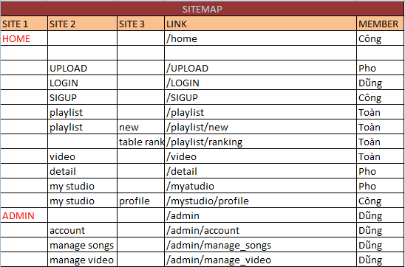
WORK

Slide 6

SCORE CALCULATION
SCORE
=
SCORE RATING
+
SCORE VIEWS
=
Likes of song - Dislikes of song
X 1000
SCORE RATING
Total likes top 30 – Total Dislikes top 30
=
Views of song
X 2000
SCORE VIEWS
Total views top 30

Slide 7
THANK YOU

